Slide 1

OPTIMIZED RENEWABLE ENERGY INTEGRATION: ADVANCED MODELING, CONTROL AND DESIGN OF A STANDALONE MICROGRID
Shiva Talebi
Department of Electrical and Computer Engineering
Supervisor: Dr. Hamed H. Aly
Committee Members: Dr. Ya-Jun Pan and Dr. Ezz El-Masry

Slide 2
Outline
Introduction to renewable energy sources
Proposed System Design
System Modeling and Optimization Objectives
Optimization Methods
Results and Discussion
Conclusion and Future Work

Slide 3
Transition to Renewable Energy Sources
Challenges of Fossil Fuels:
Harmful environmental impact (e.g., CO2 emissions).
Non-renewable and finite resources.
Shift to Renewable Energy Sources (RESs):
Clean and reliable alternative.
Essential for modern microgrids due to climate change concerns.
Challenges with RESs:
Intermittency (e.g., solar and wind depend on weather and meteorological data).
Need for proper energy management:
Incorporate energy storage systems.
Optimize hybrid RESS combinations in the grid for efficiency.
Aspects of Optimization:
Reduce total system cost.
Enhance reliability.
Maximize renewable integration.
Minimize pollution emissions.

Slide 4
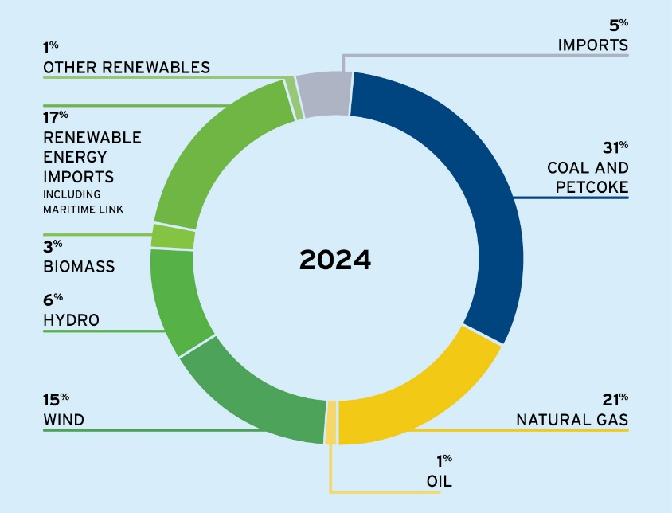
Available renewable energy sources in Nova Scotia
Common RESS: Solar, wind and biomass
Uncommon RESS: Tidal energy
Has advantages over other renewables because:
High power density
more predictability of tidal currents.
Figure 1 – Energy sources used to produce electricity in Nova Scotia, 2024
Notes:
For stepping toward more sustainability it is important to use other available resources such as tidal energy.

Slide 5
Battery Energy Storage System Technologies
The most used batteries : lead acid and lithium-ion (Li-ion)
Lead acid:
Modest battery efficiency (70 – 90 %)
5 – 15 years expected lifetime.
Disadvantages: Low energy density and restricted cycling ability
Lithium-ion
High energy density,
High efficiency (85-98 %)
Expected lifetime of 5 to 15 years
Low self-discharge rate
Highly portable
Fast response time.
Disadvantages: High cost and the safety issues due to overheat

Slide 6
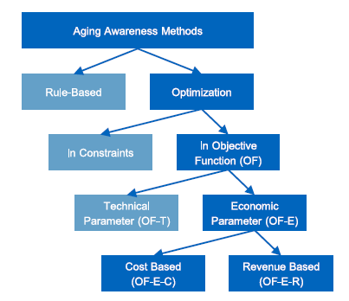
Battery Degradation
Charging and discharging the batteries leads to degradation, which can cause an increase in battery cell resistance, capacity loss, and safety matters.
Common external stress factors:
The depth of discharge (DOD)
The circulated current throughout the BESS
The ambient temperature of the cells
The state of charge (SOC)
Treating degradation as an economic factor is more reasonable for consumer-level applications where cost efficiency is essential.
Figure 2 – Battery degradation approaches
Notes:
BESS balance supply and demand by storing excess energy for later use, and it is necessary to use them to optimize various aspects such as capacity, cost, and power quality of the system.

Slide 7
Optimization Methods in Literature
Probabilistic method:
Uses probability to explore the solution space.
Generally suitable for larger search spaces but need many converge iterations.
Can only be used in a system with only one or two components.
Mathematical-based method:
Uses mathematical models to solve the optimization problem
Highly accurate for linear problems but do not fit with non-linear or mixed-integer problems
Heuristic method:
Well-structured for solving complex and non-linear problems without requiring extra information about gradients and differentiable components.
Hybrid method:
Superior to other methods
Combines two or more optimization techniques to increase the strength of those algorithms and improve the accuracy and convergence speed

Slide 8
Comparison with Literature
Table 1 - Comparative study of methods used in literature
Author | Grid Components | Method | Objectives | Summary | Research gaps
D. Emad et al [2] | PV/Wind/Battery | GWO | Cost, LPSP | - Strong focus on techno-economic optimization, addressing cost and reliability. - Comprehensive evaluation of LPSP thresholds | - Battery degradation is not addressed - Standalone/non-hybrid algorithms used
M. S. Javed et al [3] | PV/Wind/Battery | FA/PSO/GA/ACO | Cost | - Deep analysis of multiple heuristic algorithms. - Inclusion of Pumped Hydro Storage (PHS) as an innovative energy storage option. | - Battery degradation is not addressed - Standalone/non-hybrid algorithms used
Ntube et al [4] | PV/Battery | MILP and Monte Carlo | Cost, total energy imported | - Uses a traditional Mixed Integer Linear Programming (MILP) approach, and a detailed Monte Carlo-based sensitivity analysis for better scenario evaluation. | -Focuses solely on PV systems - Battery degradation is not addressed - Reliability (LPSP) is not mentioned - Methods used are not well suited for non-linear problems.
Ayotunde A. Adeyemo et al [5] | PV/Hydrogen/battery | NSGAII | Cost, LPSP and potential energy waste probability | -Economic and technical analysis. -An in-house simplified degradation model was used to evaluate the capacity loss. | - Not using a hybrid algorithm which offers better exploration and convergence. - Does not integrate reliability metrics (LPSP) with degradation impacts.
V. Khare et al [6] | PV/Tidal/battery system | Chaotic Particle Swarm Optimization and Cuckoo Optimization | Cost | Focus on Solar-Tidal Integration to minimize the costs | - Battery degradation is not addressed - Standalone/non-hybrid algorithms used - Reliability of the system (LPSP) is not mentioned

Slide 9
Research Gaps
Battery degradation:
Complexity in Modeling
Multiple internal and external factors influence battery degradation, (DOD, SOC, etc.) and cannot be modeled directly.
Computational limitations
In traditional optimization methods, it is challenging to express battery degradation because of its non-linear behavior.
Different battery technologies
Battery degradation can be different in various battery technologies.
Tidal Energy:
Tidal energy is only viable in coastal and high-current regions.
Accurate tidal resource prediction requires consideration of tidal cycles, seasonal variations, and water depth, which adds complexity to optimization models.
Tidal turbines are new technologies, with fewer commercially available models and limited real-world data for cost and performance analysis.

Slide 10
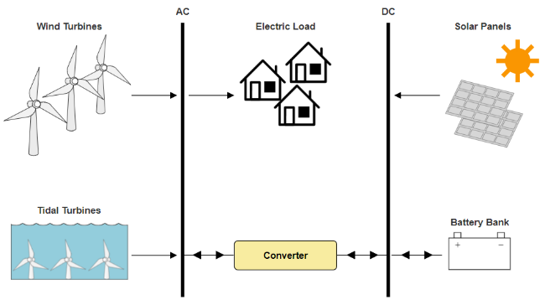

Proposed System Design
Renewable Energy Sources:
Solar, wind, and tidal energy systems modeled with meteorological and operational parameters.
Battery Energy Storage System (BESS):
Balances supply and demand through efficient charging and discharging.
Optimization Objectives:
Cost-reduction and reliability leading to efficient renewable integration.
Figure 3 - Standalone PV/WT/Tidal/BESS configuration
Figure 4 – Location of the case study

Slide 11
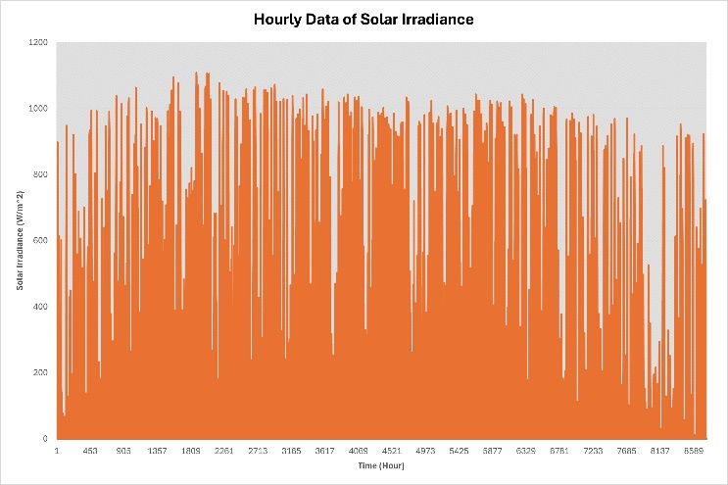
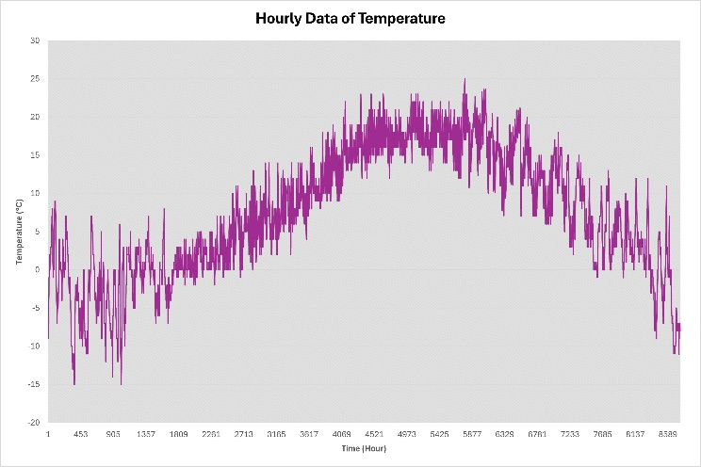
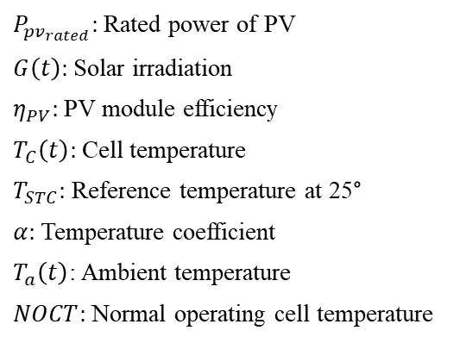
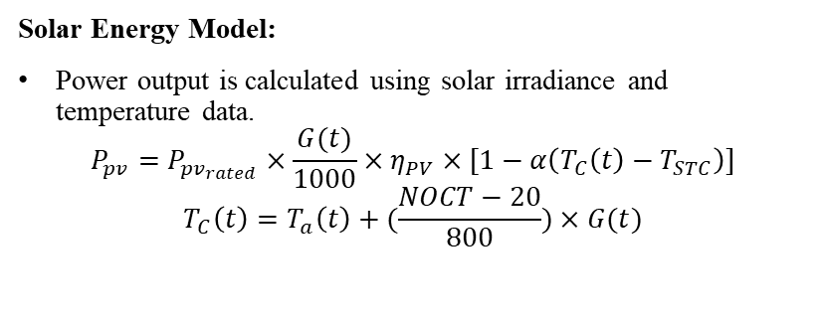
Modeling of Photovoltaic Panels
Solar Energy Model:
Power output is calculated using solar irradiance and temperature data.
$$P_{pv}=P_{{pv}_{rated}}×\frac{G(t)}{1000}×η_{PV}×[1−α\left(T_{C}\left(t\right)−T_{STC}\right)]$$
$$T_{C}\left(t\right)=T_{a}\left(t\right)+(\frac{NOCT−20}{800})×G(t)$$
$P_{{pv}_{rated}}:$Rated power of PV
$G\left(t\right):$Solar irradiation
$η_{PV}:$PV module efficiency
$T_{C}\left(t\right):$Cell temperature
$T_{STC}:$ Reference temperature at 25°
$α:$Temperature coefficient
$T_{a}\left(t\right)$: Ambient temperature
$NOCT:$Normal operating cell temperature
Figure 5 - Hourly data of solar irradiance
Figure 6 - Hourly data of ambient temperature

Slide 12
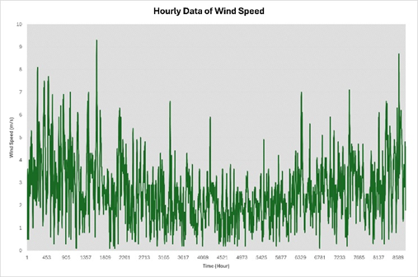
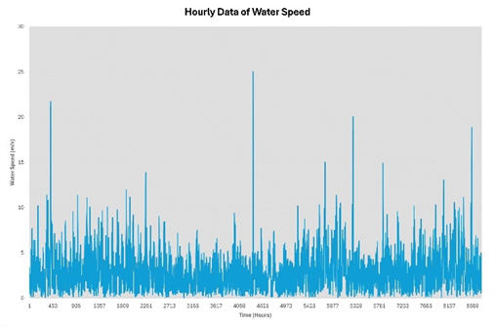
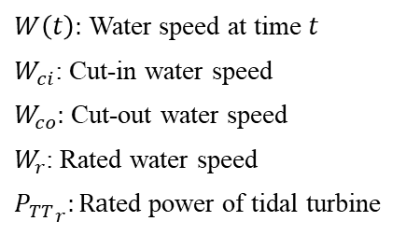
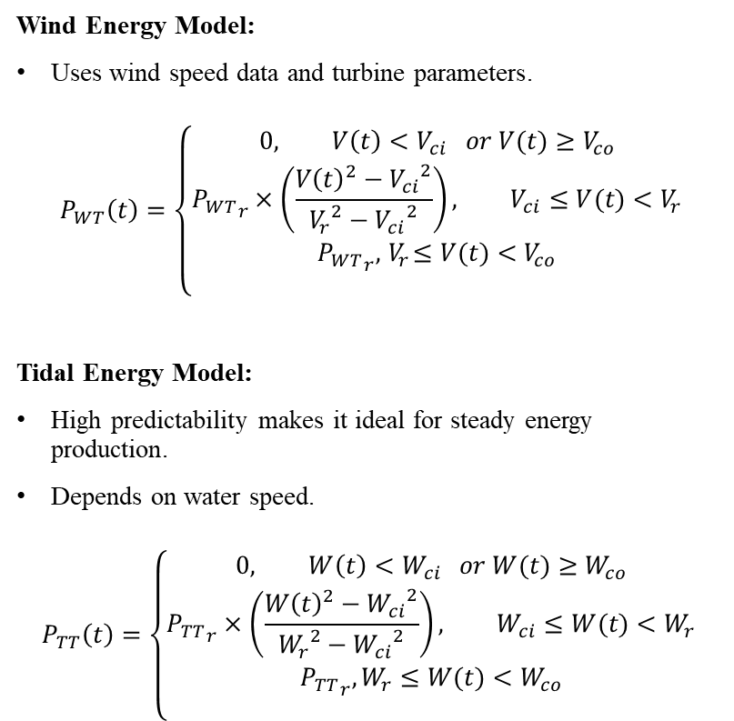
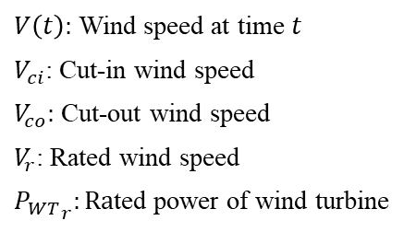
Modeling of Wind and Tidal Turbines
Wind Energy Model:
Uses wind speed data and turbine parameters.
$$P_{WT}\left(t\right)=\left\{\begin{matrix}\begin{aligned}0, V\left(t\right)<V_{ci} or V(t)≥V_{co} \\ {P_{WT}}_{r}×\left(\frac{{V\left(t\right)}^{2}−{V_{ci}}^{2}}{{V_{r}}^{2}−{V_{ci}}^{2}}\right), V_{ci}≤V(t)<V_{r}\end{aligned} \\ {P_{WT}}_{r},{ V}_{r}≤V(t)<V_{co} \\ \end{matrix}\right.$$
Tidal Energy Model:
High predictability makes it ideal for steady energy production.
Depends on water speed.
$$P_{TT}\left(t\right)=\left\{\begin{matrix}\begin{aligned}0, W\left(t\right)<W_{ci} or W(t)≥W_{co} \\ {P_{TT}}_{r}×\left(\frac{{W\left(t\right)}^{2}−{W_{ci}}^{2}}{{W_{r}}^{2}−{W_{ci}}^{2}}\right), W_{ci}≤W(t)<W_{r}\end{aligned} \\ {P_{TT}}_{r}, W_{r}≤W(t)<W_{co} \\ \end{matrix}\right.$$
$V\left(t\right):$ Wind speed at time $t$
$V_{ci}$: Cut-in wind speed
$V_{co}:$ Cut-out wind speed
$V_{r}$: Rated wind speed
${P_{WT}}_{r}:Ra$ted power of wind turbine
Figure 7 - Hourly data of wind speed
$W\left(t\right):$ Water speed at time $t$
$W_{ci}$: Cut-in water speed
$W_{co}:$ Cut-out water speed
$W_{r}$: Rated water speed
${P_{TT}}_{r}:Ra$ted power of tidal turbine
Figure 8 - Hourly data of water speed

Slide 13
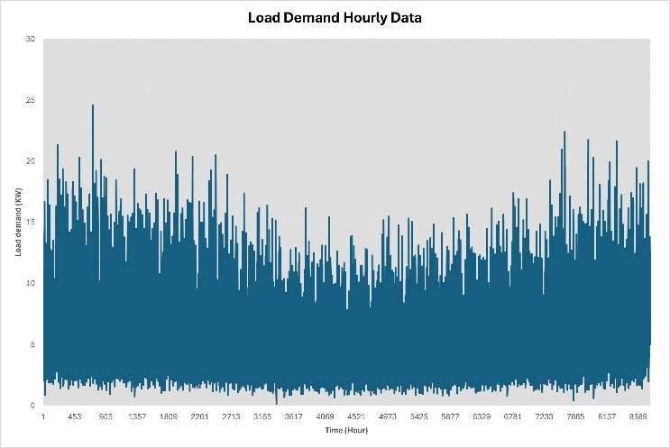
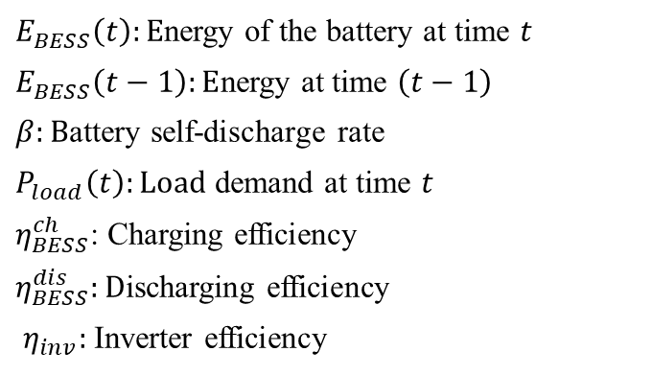
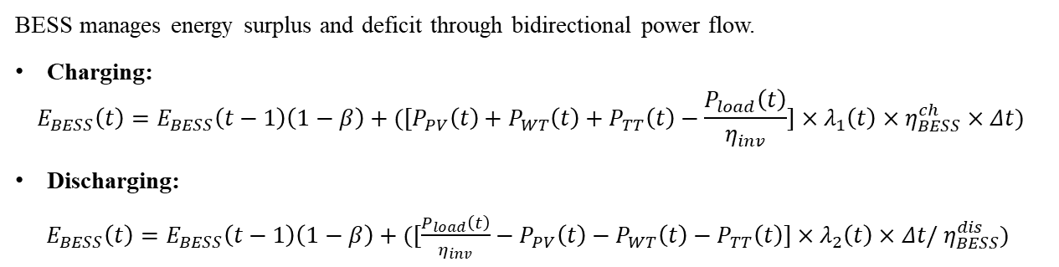
Modeling of Battery Energy Storage System
BESS manages energy surplus and deficit through bidirectional power flow.
Charging:
$$E_{BESS}\left(t\right)=E_{BESS}\left(t−1\right)\left(1−β\right)+([P_{PV}\left(t\right)+P_{WT}\left(t\right)+P_{TT}\left(t\right)−\frac{P_{load}\left(t\right)}{η_{inv}}]×λ_{1}\left(t\right)×η_{BESS}^{ch}×Δt)$$
Discharging:
$E_{BESS}\left(t\right)=E_{BESS}\left(t−1\right)\left(1−β\right)+([\frac{P_{load}\left(t\right)}{η_{inv}}−P_{PV}\left(t\right)−P_{WT}\left(t\right)−P_{TT}\left(t\right)]×λ_{2}\left(t\right)×Δt/{ η}_{BESS}^{dis})$
$E_{BESS}\left(t\right):E$nergy of the battery at time $t$
$E_{BESS}\left(t−1\right):E$nergy at time $\left(t−1\right)$
$β:B$attery self-discharge rate
$P_{load}\left(t\right):Load$ demand at time $t$
$η_{BESS}^{ch}$: Charging efficiency
$η_{BESS}^{dis}:D$ischarging efficiency
$η_{inv}:$Inverter efficiency
Figure 9 - Hourly data of load demand

Slide 14
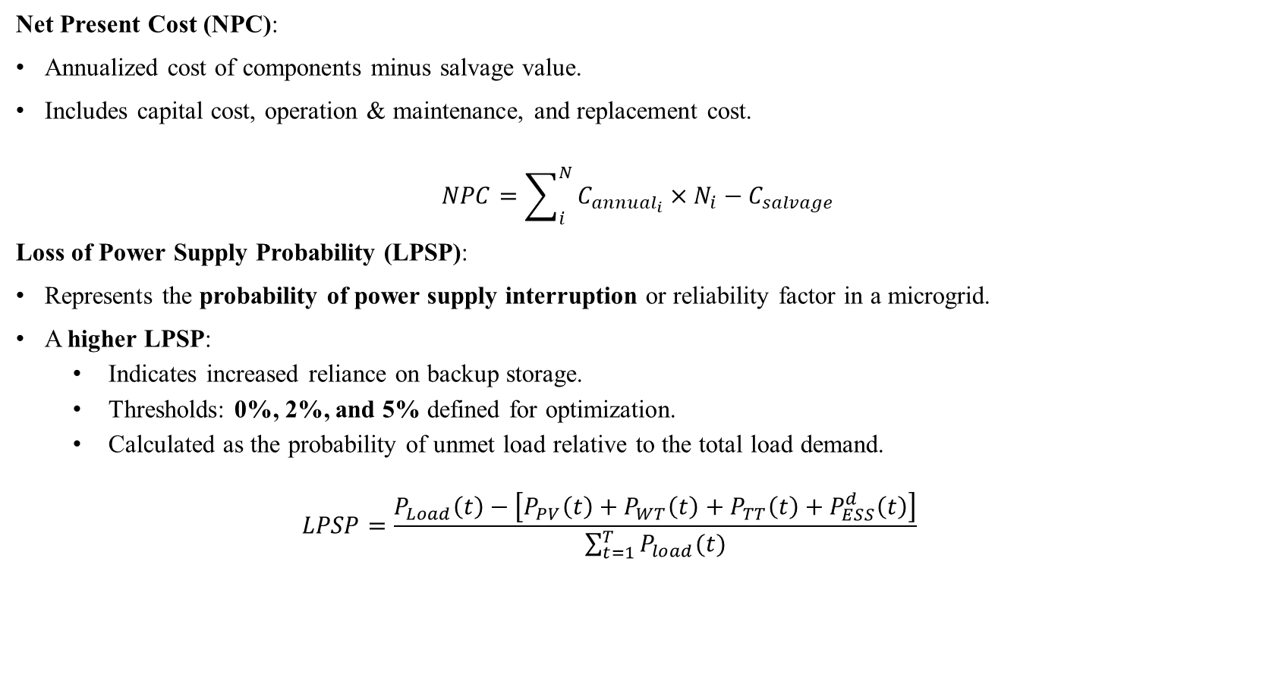
Objective Functions
Net Present Cost (NPC):
Annualized cost of components minus salvage value.
Includes capital cost, operation & maintenance, and replacement cost.
$$NPC=\sum_{i}^{N}{C_{{annual}_{i}}}×N_{i}−C_{salvage}$$
Loss of Power Supply Probability (LPSP):
Represents the probability of power supply interruption or reliability factor in a microgrid.
A higher LPSP:
  Indicates increased reliance on backup storage.
  Thresholds: 0%, 2%, and 5% defined for optimization.
  Calculated as the probability of unmet load relative to the total load demand.
  $$LPSP=\frac{P_{Load}\left(t\right)−\left[P_{PV}\left(t\right)+P_{WT}\left(t\right)+P_{TT}\left(t\right)+P_{ESS}^{d}\left(t\right)\right]}{\sum_{t=1}^{T}{P_{load}(t)}}$$

Slide 15
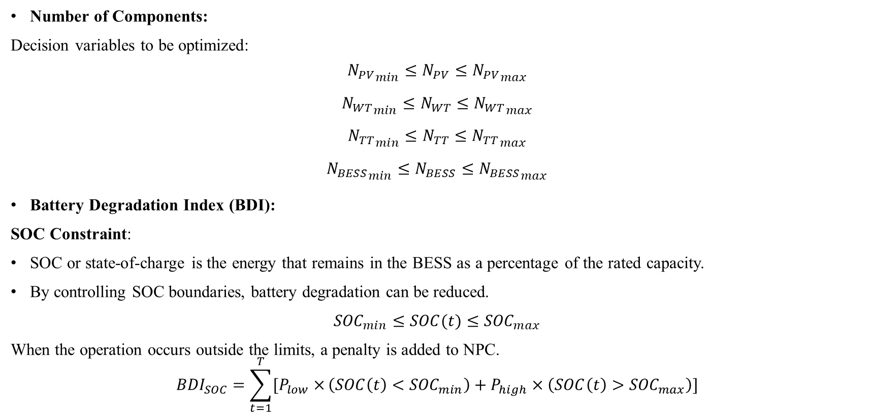
Constraints
Number of Components:
Decision variables to be optimized:
${N_{PV}}_{min}≤N_{PV}≤{N_{PV}}_{max}$
${N_{WT}}_{min}≤N_{WT}≤{N_{WT}}_{max}$
${N_{TT}}_{min}≤N_{TT}≤{N_{TT}}_{max}$
${N_{BESS}}_{min}≤N_{BESS}≤{N_{BESS}}_{max}$
Battery Degradation Index (BDI):
SOC Constraint:
SOC or state-of-charge is the energy that remains in the BESS as a percentage of the rated capacity.
By controlling SOC boundaries, battery degradation can be reduced.
${SOC}_{min}≤SOC(t)≤{SOC}_{max}$
When the operation occurs outside the limits, a penalty is added to NPC.
$${BDI}_{SOC}=\sum_{t=1}^{T}{[P_{low}×}\left(SOC\left(t\right)<{SOC}_{min}\right)+P_{high}×\left(SOC\left(t\right)>{SOC}_{max}\right)]$$
The initial values were selected as 75 PV panels, 5 wind turbines, 2 tidal turbines, and 20 batteries with trial and error.

Slide 16
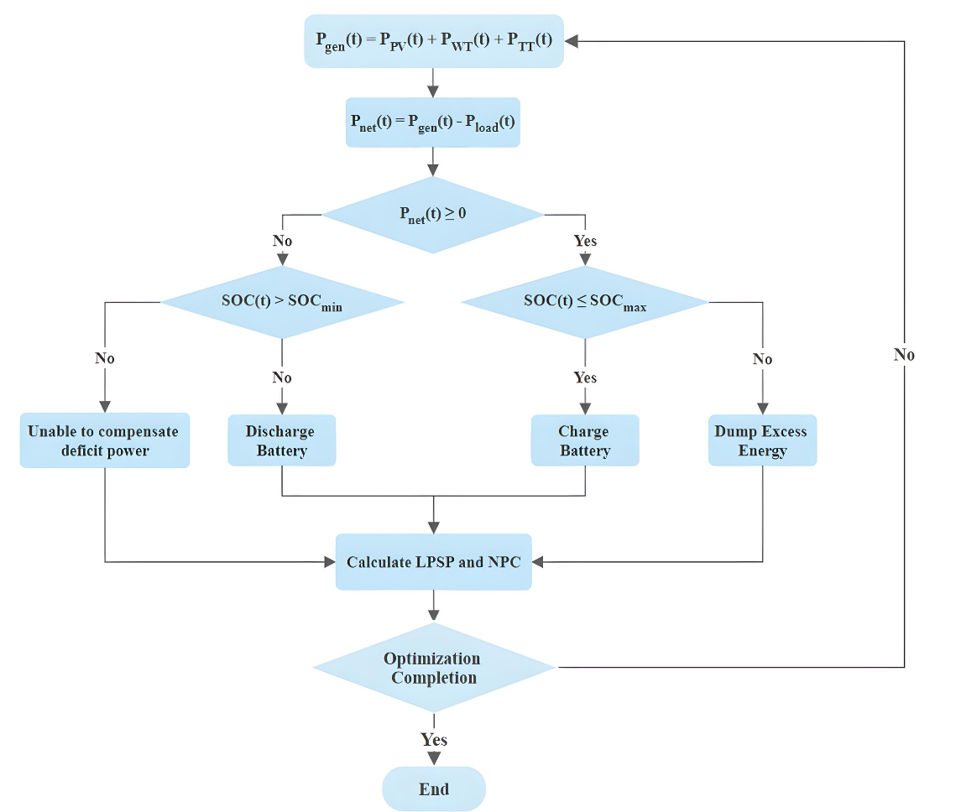
Energy Management Strategy
Excess Power Generation:
When power generated > load demand:
Excess energy is used to charge the battery until it reaches its maximum capacity.
Any remaining energy is dumped to avoid overloading.
Deficient Power Generation:
When power generated < load demand:
Stored battery energy compensates for the shortfall (discharge) until the battery reaches its minimum capacity.
If the battery reaches its lower limit: The LPSP factor is updated to account for unmet load.
Figure 10 - Flowchart of sizing strategy

Slide 17
Parameter Values
Table 2 - Wind turbine and tidal turbine parameters
Table 3 - PV panels and converter parameters
Wind Turbine | Values | Tidal Turbine | Values
Rated power | 10 KW | Rated power | 20 KW
Cut in speed | 4 m/s | Cut in speed | 1 m/s
Cut out speed | 25 m/s | Cut out speed | 5 m/s
Rated Speed | 12 m/s | Rated Speed | 3 m/s
Capital and replacement costs | 50,000 $ | Capital and replacement costs | 125,000 $
O&M costs | 500 $ | O&M costs | 700 $
Lifetime | 20 years | Lifetime | 20 years
PV panels | Values | Converter | Values
Rated Capacity | 4.4 KW | Relative capacity | 100%
Temp. coefficient | -0.41 | Inverter efficiency | 95%
NOCT | 45 °C | Rectifier efficiency | 95%
Efficiency | 17.3% | Capital costs | 300 $
Capital and replacement costs | 3,000 $ | Replacement costs | 300 $
O&M costs | 10 $ | O&M costs | 1000 $
Lifetime | 25 years | Lifetime | 15 years
Table 4 – Battery energy storage system parameters
BESS I | Values | BESS II | Values
Type | Li-ion | Type | Lead acid
Nominal voltage | 720 V | Nominal voltage | 8 V
Nominal capacity | 55.8 kWh | Nominal capacity | 21.2 kWh
Maximum capacity | 77.6 Ah | Maximum capacity | 2650 Ah
Minimum SOC | 5% | Minimum SOC | 40%
Capital costs | 60,000 $ | Capital costs | 2806 $
Replacement costs | 36,000 $ | Replacement costs | 2806 $
O&M costs | 6000 $ | O&M costs | 10 $

Slide 18
Which Method to Use?
Why Heuristic Methods?:
Ideal for solving complex and non-linear problems.
Do not require:
  Gradient information.
  Differentiable components (unlike analytical or mathematical methods).
Well-suited for the proposed system, given its complexity and non-linearity.
Algorithms Used:
Four common heuristic algorithms from the literature were applied to the system:
  Firefly Algorithm (FA)
  Particle Swarm Optimization (PSO)
  Ant Colony Optimization (ACO)
  Genetic Algorithm (GA)
Top two algorithms selected based on:
Best Objective Function Performance.
Analytical Data Error Comparison.

Slide 19
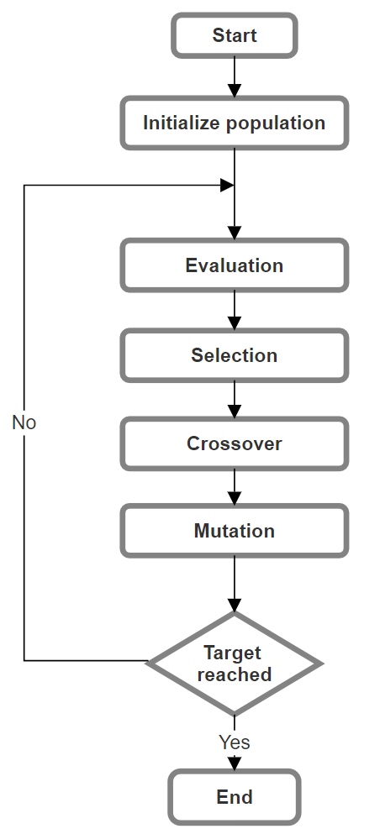
Genetic Algorithm (GA)
Initialization
Generate an initial population of random individuals.
Evaluation
Calculate the fitness of each individual in the population to evaluate how good each solution is.
Selection
Select parents for reproduction based on their fitness.
Crossover
By combining the genetic material of selected parents, we apply crossover techniques to generate new solutions/offspring.
Mutation
Introduce random mutations in the offspring to maintain diversity .
Replacement
Some or all the old population with the new offspring get replaced.
Stopping Criterion
Algorithm stops when the best solution is found or after a set number of iterations.
Figure 11 – Flowchart of GA

Slide 20
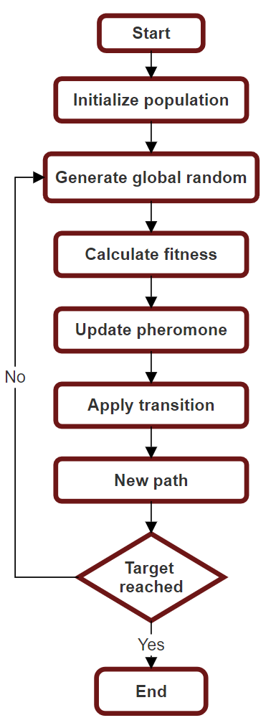
Ant Colony Optimization (ACO)
Inspired by the natural behavior of ant colonies.
Initialization
Generate an initial population of random individuals.
Solution Construction
Each ant makes decisions based on both pheromone levels and heuristic information. The algorithm explores various possible solutions while being guided by previous successful paths.
Pheromone Update
The pheromone trails are modified based on the quality of solutions found. Better solutions are more attractive for future iterations.
Stopping Criterion
Algorithm stops when the best solution is found or after a set number of iterations
Figure 12 – Flowchart of ACO

Slide 21
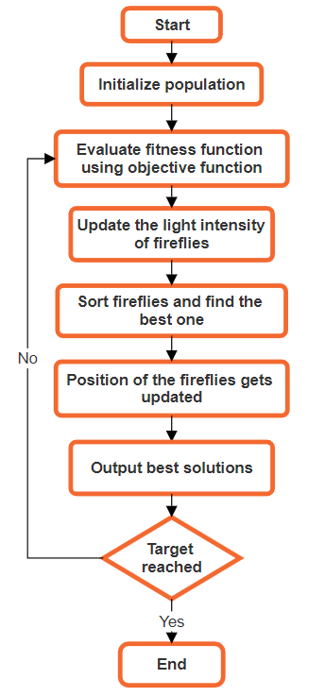
Firefly Algorithm (FA)
Inspired by the behavior of fireflies.
Fireflies communicate using flashes of light.
Algorithm Process:
Initialization:
  Generate an initial population of fireflies.
Fitness Evaluation:
  Evaluate the fitness of each firefly using the objective function.
Position Update:
  Update positions of fireflies based on their light intensity (brightness).
Stopping Criterion:
  Algorithm stops when the best solution is found or after a set number of iterations.
Figure 13 - Flowchart of firefly algorithm

Slide 22
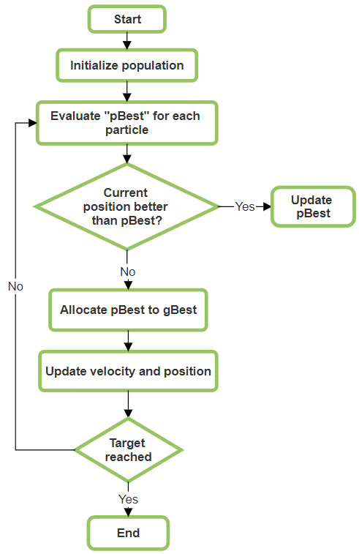
Particle Swarm Optimization (PSO)
Inspired by natural behaviors like the coordinated movement of bird flocks.
  In PSO a group of potential solutions called particles.
  Each particle represented by a vector array of velocity and position.
Particles share information with their neighbors and rely on past experiences to improve exploration and exploitation in the search space.
Algorithm Process:
Initialization:
  Generate a random swarm of particles with initial positions and velocities.
Fitness Evaluation:
  Evaluate the fitness of each particle using the objective function.
Tracking Best Positions:
  Personal Best: Keep track of each particle's best position.
  Global Best: Identify the best position across the entire swarm.
Velocity and Position Update
Stopping Criterion
Figure 14 - Flowchart of PSO

Slide 23
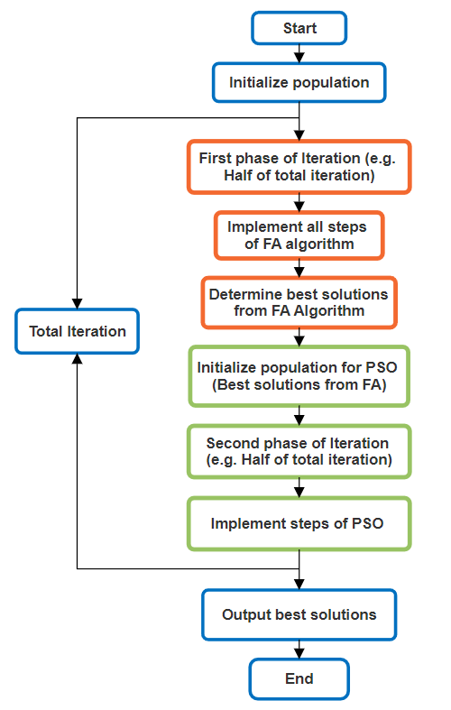
Hybrid FA-PSO
Combines the strengths of FA and PSO:
FA excels at broad exploration and avoids premature convergence.
PSO has a simpler implementation with fewer parameters and achieves faster convergence.
Hybrid Approach:
Exploration with FA:
  FA is used first to explore the search space thoroughly.
  Helps prevent getting stuck in local optima.
Refinement with PSO:
  Best solutions from FA are passed as the initial population for PSO.
  PSO refines these solutions using its velocity-driven updates for efficient convergence.
Figure 15 - Flowchart of FA-PSO

Slide 24
Genetic Algorithm Results
Table 5 – Optimization results for GA – Lead Acid battery
Algorithm | LPSP | Best NPC ($) | No. PV | No. WT | No. TT | No. BESS
GA | 0% | 587,114 | 50 | 1 | 1 | 2
 | 2% | 586,114 | 50 | 1 | 1 | 2
 | 5% | 584,614 | 50 | 1 | 1 | 2
Table 6 - Optimization results for GA – Li-ion battery
Algorithm | LPSP | Best NPC ($) | No. PV | No. WT | No. TT | No. BESS
GA | 0% | 779,683 | 50 | 1 | 1 | 2
 | 2% | 778,683 | 50 | 1 | 1 | 2
 | 5% | 777,183 | 50 | 1 | 1 | 2
Table 7 – Statistical analysis results for GA – lead acid battery
Algorithm | LPSP | MAE | RMSE | RE
GA | 0% | 5816.14 | 48245.98 | 0.99
 | 2% | 12554.88 | 65919.35 | 2.14
 | 5% | 12748.48 | 61624.11 | 2.18
Table 8 - Statistical analysis results for GA – Li-ion battery
Algorithm | LPSP | MAE | RMSE | RE
GA | 0% | 8159.99 | 57699.91 | 0.01
 | 2% | 38712.62 | 223157.99 | 0.04
 | 5% | 20218.95 | 118079.47 | 0.02
Figure 16 - Convergence curves for GA

Slide 25
ACO Results
Table 9 - Optimization results for ACO – Lead acid battery
Algorithm | LPSP | Best NPC ($) | No. PV | No. WT | No. TT | No. BESS
ACO | 0% | 823,411 | 86 | 1 | 1 | 15
 | 2% | 605,085 | 62 | 1 | 1 | 2
 | 5% | 567,137 | 55 | 1 | 1 | 3
Table 10 - Statistical analysis results for ACO – Lead acid battery
Algorithm | LPSP | MAE | RMSE | RE
ACO | 0% | 82627.90 | 181026.89 | 10.03
 | 2% | 109770.43 | 239339.82 | 18.14
 | 5% | 143289.77 | 291022.64 | 25.26
Table 11 - Optimization results for ACO – Li-ion battery
Algorithm | LPSP | Best NPC ($) | No. PV | No. WT | No. TT | No. BESS
ACO | 0% | 1,003,180 | 96 | 1 | 1 | 2
 | 2% | 845,750 | 53 | 1 | 1 | 3
 | 5% | 724,220 | 50 | 1 | 1 | 2
Table 12 - Statistical analysis results for ACO – Li-ion battery
Algorithm | LPSP | MAE | RMSE | RE
ACO | 0% | 474580.11 | 797863.72 | 0.47
 | 2% | 272707.65 | 611172.53 | 0.32
 | 5% | 308281.34 | 619301.38 | 0.42
Figure 17 - Convergence curves for GA

Slide 26
FA results
Table 13 - Optimization results for FA – Lead acid battery
Algorithm | LPSP | Best NPC ($) | No. PV | No. WT | No. TT | No. BESS
FA | 0% | 537,643 | 50 | 1 | 1 | 2
 | 2% | 536,643 | 50 | 1 | 1 | 2
 | 5% | 535,134 | 50 | 1 | 1 | 2
Table 14 - Statistical analysis results for FA – Lead acid battery
Algorithm | LPSP | MAE | RMSE | RE
FA | 0% | 108050.93 | 206971.02 | 20.09
 | 2% | 66785.80 | 153036.90 | 12.44
 | 5% | 85348.37 | 161041.99 | 15.94
Table 15 - Optimization results for FA – Li-ion battery
Algorithm | LPSP | Best NPC ($) | No. PV | No. WT | No. TT | No. BESS
FA | 0% | 730,234 | 50 | 1 | 1 | 2
 | 2% | 729,234 | 50 | 1 | 1 | 2
 | 5% | 727,734 | 50 | 1 | 1 | 2
Table 16 - Statistical analysis results for FA – Li-ion battery
Algorithm | LPSP | MAE | RMSE | RE
FA | 0% | 104857.02 | 388417.18 | 0.14
 | 2% | 148890.99 | 528102.88 | 0.17
 | 5% | 107258.72 | 406226.87 | 0.14
Figure 18 - Convergence curves for FA

Slide 27
PSO results
Table 17 - Optimization results for PSO – Lead acid battery
Algorithm | LPSP | Best NPC ($) | No. PV | No. WT | No. TT | No. BESS
PSO | 0% | 520,139 | 48 | 1 | 1 | 11
 | 2% | 487,353 | 45 | 1 | 1 | 7
 | 5% | 484,528 | 44 | 1 | 1 | 8
Table 18 - Statistical Analysis results for PSO – Lead acid battery
Algorithm | LPSP | MAE | RMSE | RE
PSO | 0% | 67971.39 | 102102.10 | 0.13
 | 2% | 10162.95 | 69833.38 | 0.02
 | 5% | 126128.95 | 187878.28 | 0.26
Table 19 - Optimization results for PSO – Li-ion battery
Algorithm | LPSP | Best NPC ($) | No. PV | No. WT | No. TT | No. BESS
PSO | 0% | 704,596 | 21 | 1 | 1 | 4
 | 2% | 691,021 | 14 | 1 | 1 | 2
 | 5% | 687,632 | 10 | 1 | 1 | 2
Table 20 - Statistical Analysis results for PSO – Li-ion battery
Algorithm | LPSP | MAE | RMSE | RE
PSO | 0% | 2641.0 | 18674.69 | 0.003
 | 2% | 24449.22 | 63919.55 | 0.035
 | 5% | 10495.10 | 60962.51 | 0.01
Figure 19 - Convergence curves for PSO

Slide 28
Conclusion of four algorithms
PSO consistently outperforms all other algorithms:
The lowest NPC for both Li-ion and Lead-acid batteries.
Converges faster with fewer system components.
FA appears as the second-best algorithm:
A strong balance between exploration and cost efficiency.
Occasionally showing higher deviations from the optimal solution.
GA is stable and reliable with both battery types
Unable to match the cost reductions of PSO and FA.
ACO is the least efficient algorithm:
Significantly higher NPC values and struggles with convergence and accuracy.
More reliability is established with an LPSP of 0%, but at a higher cost.
LPSPs of 2% and 5% are also reasonable options for a balance between reliability and cost-effectiveness.
Table 21 - Optimization results comparison
Algorithm | LPSP | Best NPC ($) – Lead Acid Battery | Best NPC ($) – Li-ion Battery
GA | 0% | 587,114 | 779,683
 | 2% | 586,114 | 778,683
 | 5% | 584,614 | 777,183
ACO | 0% | 823,411 | 1,003,180
 | 2% | 605,085 | 845,750
 | 5% | 567,137 | 724,220
FA | 0% | 537,643 | 730,234
 | 2% | 536,643 | 729,234
 | 5% | 535,134 | 727,734
PSO | 0% | 520,139 | 704,596
 | 2% | 487,353 | 691,021
 | 5% | 484,528 | 687,632

Slide 29
Hybrid FA-PSO Optimization Results
Table 22 - Optimization Results for FA-PSO (LPSP 5%)
Table 23 - Statistical Analysis (RE) Comparison results
BESS Type | Best NPC ($) | No. PV | No. WT | No. TT | No. BESS
Lead Acid | 460,874 | 50 | 1 | 1 | 2
Li-ion | 653,630 | 50 | 1 | 1 | 2
BESS Type | PSO | FA | FA-PSO
Lead Acid | 0.26 | 15.94 | 0.38
Li-ion | 0.14 | 0.01 | 0.46
Figure 20 - Convergence curves comparison of hybrid FA-PSO for Li-ion battery
Figure 21 - Convergence curves comparison of hybrid FA-PSO for lead acid battery

Slide 30
Homer Results Comparison
Table 24 – Optimization results comparison of HOMER and FA-PSO, Li-ion battery
Algorithm | LPSP | Best NPC ($) | No. PV | No. WT | No. TT | No. BESS
HOMER | - | 1,688,996 | 9 | 5 | 1 | 8
FA-PSO | 0% | 1,442,890 | 26 | 4 | 1 | 8
 | 2% | 1,376,780 | 15 | 4 | 1 | 8
 | 5% | 1,328,700 | 7 | 5 | 1 | 8
Figure 22 – Convergence curves for hybrid FA-PSO using the search space of HOMER, Li-ion battery
Table 25 - Optimization results comparison of HOMER and FA-PSO, lead acid battery
Algorithm | LPSP | Best NPC ($) | No. PV | No. WT | No. TT | No. BESS
HOMER | - | 1,153,678 | 9 | 5 | 1 | 43
FA-PSO | 0% | 899,246 | 8 | 5 | 1 | 53
 | 2% | 868,230 | 15 | 5 | 1 | 40
 | 5% | 826,160 | 8 | 5 | 1 | 40
Figure 23 - Convergence curves for hybrid FA-PSO using the search space of HOMER, lead acid battery

Slide 31
Validation
In order to validate our work, the proposed hybrid FA-PSO algorithm was applied to another site from paper [2] and obtained a better result.
Table 26 - Comparison of optimization results for Standalone grid at Sinai in Egypt
Algorithm | LPSP | Best NPC ($) | No. PV | No. WT | No. BESS
HOMER | - | 175,605 | 476 | 10 | 336
GWO | 0% | 146,400 | 420 | 7 | 336
 | 2% | 132,160 | 320 | 7 | 320
 | 5% | 120,210 | 294 | 5 | 352
FA-PSO | 0% | 139,665 | 337 | 5 | 465
 | 2% | 125,679 | 365 | 5 | 300
 | 5% | 117,927 | 300 | 5 | 300
Figure 24 - Convergence curves for FA-PSO applied to standalone PV/WT/BESS grid) at Sinai in Egypt, Sinai.
Figure 25 – Stand-alone micro-grid in Egypt, Sinai

Slide 32
Analysis of SOC, Charging and Discharging of Batteries
Figure 26 - SOC over time for li-ion battery
Figure 27 - SOC over time for lead acid battery
Notes:
li-ion batteries have a broader range of SOC (0.05 to 0.8) compared to lead acid batteries (0.4 to 0.8). an initial charge of 50% is used for the batteries. Additionally, as a cell ages maximum SOC decreases. Thus, what represents a full charge (100% SOC) in a new cell would only translate to approximately 75% to 80% SOC in an older cell. Maintaining a maximum SOC of 80% in a battery is often recommended to significantly extend its lifespan by minimizing stress on the battery cells.

Slide 33
Li-ion batteries charge and discharge more frequently and with greater power fluctuations indicates their ability to be adapted for variable renewable energy and load conditions.
On the other hand, in lead acid batteries, charging and discharging are less frequent and operate at lower power levels but also suits a cost-sensitive scenario.
Figure 28 - Charging and discharging power of lead acid battery
Figure 29 - Charging and discharging power of li-ion battery

Slide 34
Hybrid Methods Comparison
Table 27 - Comparison of different hybrid techniques
Hybrid Approach | Exploration | Exploitation | Convergence Speed | Computational Efficiency
GA-ACO | High (Both GA and ACO focus on exploration) | Low (Neither has a strong local search mechanism) | Slow (ACO’s pheromone reinforcement takes time) | High (GA’s offspring generation + ACO’s pheromone updating)
GA-PSO | Moderate (GA explores, PSO converges quickly) | High (PSO ensures rapid refinement) | Fast (PSO has strong convergence speed) | Moderate (GA requires crossover/mutation, but PSO accelerates search)
GA-FA | High (GA explores, FA maintains diversity) | Moderate (FA maintains diversity but lacks strong local search) | Moderate (FA prevents stagnation but can be slow) | Moderate (GA mutation adds computation, FA is the opposite)
ACO-PSO | Moderate (ACO explores, PSO converges) | High (PSO ensures rapid convergence) | Fast (PSO accelerates convergence) | Moderate (ACO pheromone reinforcement adds computational overhead)
ACO-FA | High (ACO explores, FA ensures diversity) | Moderate (FA adds randomness but lacks strong local refinement) | Slow (ACO slows down solution refinement) | Moderate (ACO’s memory requirements and FA’s exploration)
FA-PSO | High (FA ensures diverse exploration) | High (PSO quickly refines solutions) | Fast (PSO has strong convergence speed) | High (FA injects randomness, PSO ensures local refinement)

Slide 35
Conclusions
Standalone Hybrid Grid Design:
  Presented the modeling and design of a standalone hybrid grid to balance the reliability and cost-effectiveness of renewable energy sources (RESs).
Different Types of Battery Energy Storage Systems (BESS):
  Investigated both Lead-Acid and Li-ion batteries:
    Lead-Acid for cost-minimization scenarios.
    Li-ion for efficiency and performance-focused systems.
Battery Degradation Consideration:
  Integrated battery degradation constraints, a factor often ignored in the literature, to ensure realistic and reliable optimization.
Tidal Energy Integration:
  Included tidal energy, which is underrepresented in hybrid renewable energy management studies.
Hybrid FA-PSO Algorithm:
  Developed a Hybrid Firefly Algorithm-Particle Swarm Optimization (FA-PSO):
    Combines global exploration of FA and fast convergence of PSO.
    Outperformed standalone methods in the literature with better performance.

Slide 36
Future Work
Adding another objective:
  A third objective, reducing the pollutants, will be investigated.
RESS Combinations:
  Evaluate scenarios with different renewable energy source (RESS) combinations for optimal grid performance.
Integration of Forecasting Techniques:
  Incorporate forecasting methods into the optimization process to address uncertainties in energy generation and demand.

Slide 37
Published/Submitted Works and Achievements
Published Conference Paper:
S. Talebi and H. H. Aly, "A Review of Battery Energy Storage System Optimization: Current State-Of- The-Art and Future Trends," 2024 International Conference on Green Energy, Computing and Sustainable Technology (GECOST), Miri Sarawak, Malaysia, 2024, pp. 116-120.
Submitted Conference paper:
2025 IEEE Canadian Conference on Electrical and Computer Engineering (CCECE), “Modeling, Design and Optimization of a Standalone PV/WT/Tidal/Storage-based Grid”.
Submitted Journal Paper:
IEEE Journal, “Optimized Renewable Energy Integration: Advanced Modeling, Control and Design of a Standalone Microgrid Using Hybrid FA-PSO”
Poster Presentation “Renewable Energy Integration through Multi-Objective Optimization” at the Nova Scotia Offshore Wind R&D Forum, Net Zero Atlantic.
Won the first place for ECED 2024 Graduate Seminar Master’s 3MT Presentation.

Slide 38
References
[1] S. Talebi and H. H. Aly, "A Review of Battery Energy Storage System Optimization: Current State-Of-The-Art and Future Trends," 2024 International Conference on Green Energy, Computing and Sustainable Technology (GECOST), Miri Sarawak, Malaysia, 2024, pp. 116-120.
[2] D. Emad, M.A. El-Hameed, A.A. El-Fergany, “Optimal techno-economic design of hybrid PV/wind system comprising battery energy storage: Case study for a remote area”, Energy Conversion and Management, Volume 249, 2021.
[3] M. S. Javed, T. Ma, J. Jurasz, S. Ahmed, J. Mikulik, “Performance comparison of heuristic algorithms for optimization of hybrid off-grid renewable energy systems”, Energy, Volume 210, 2020
[4] N. Ntube, H. Li, “Stochastic multi-objective optimal sizing of battery energy storage system for a residential home”, Journal of Energy Storage, Volume 59, 2023.
[5] Ayotunde A. Adeyemo, Olumuyiwa T. Amusan, “Modelling and multi-objective optimization of hybrid energy storage solution for photovoltaic powered off-grid net zero energy building,” Journal of Energy Storage, Volume 55, Part A, 2022, 105273.
[6] V. Khare, C. J. Khare, M. A. Bhuiyan, “Design, optimization, and data analysis of solar-tidal hybrid renewable energy system for Hurawalhi, Maldives”, Cleaner Energy Systems, 6, 2023.

Slide 39

THANK YOU
Thank You Very Much!

